Slide 1
Deep Learning for HealthCare
Kumar(kv20), Dayne(bloxham2)
May 6th 2025

Slide 2

Agenda
Introduction to the paper
References and datasets
Preprocessing
Model training
Results
Improve Reproducibility

Slide 3
Enhancing Patient Understanding with LLMs
patients who visit the hospital struggle to understand their diagnoses and prescribed treatments
doctors do not have the time to provide their patients with summaries at scale
Solution:
A Data-Centric Approach To Generate Faithful and High Quality Patient Summaries with Large Language Models
Idea …
fine-tuning or prompting LLMs with hallucination-free and high-quality data can help generate summaries and reduce hallucinations in those without losing critical clinical information

Slide 4
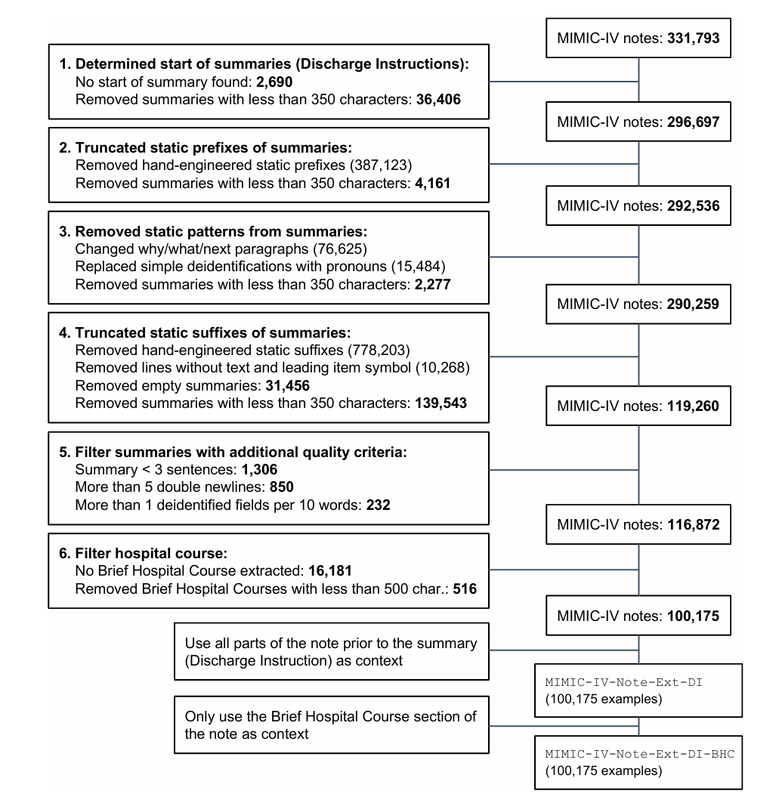
Preprocessing
Authors have spent significant effort on preprocessing with clear steps and instructions.
Once we got access to datasets from Physio.net and dealt with dataset size challenges, we could make progress.
We spent a few days understanding the steps, figuring out the Python files, and connecting to associated datasets.
We uploaded the dataset to Google Colab and ran the Python scripts listed for preprocessing step by step.
We had to resolve some issues by downloading missing packages and requested more compute to run the steps.
After multiple iterations, we successfully executed all these steps

Slide 5
Model Training
5 different models trained by authors
LED-Base & LED-Large (fine-tuned on ~80k examples)
Runtime: Training time took 8 hours on a 24GB GPU (LED-Base) and 20 hours on a 24GB GPU (LED-Large).
LLama 2 7B and 70B (LoRA fine-tuning on 100 examples)
Runtime: Training time took 1.5 hours on a single 24GB GPU (7B) and 8 hours on two 80GB GPUs while utilizing 8-bit quantization (70B).
GPT-4 (not actually trained, but evaluated using three different model versions)
Evaluated on three different prompt instructions, and two variations supplying no in-context examples (0-shot) and five in-context examples (5-shot) which performed quantitatively better
We were unable to retrain these models due to resource constraints.

Slide 6
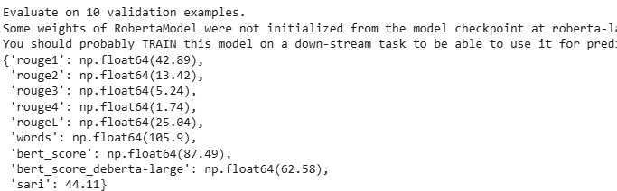
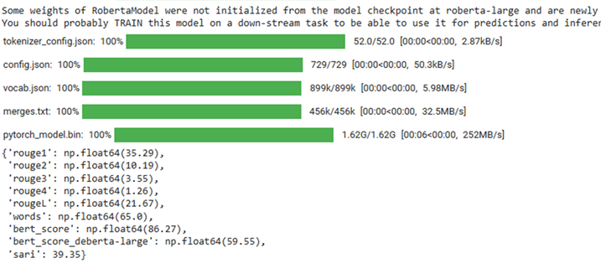
GPT Summarization Output
3 shot
Gpt 4
1 shot
Gpt 3.5 turbo

Slide 7
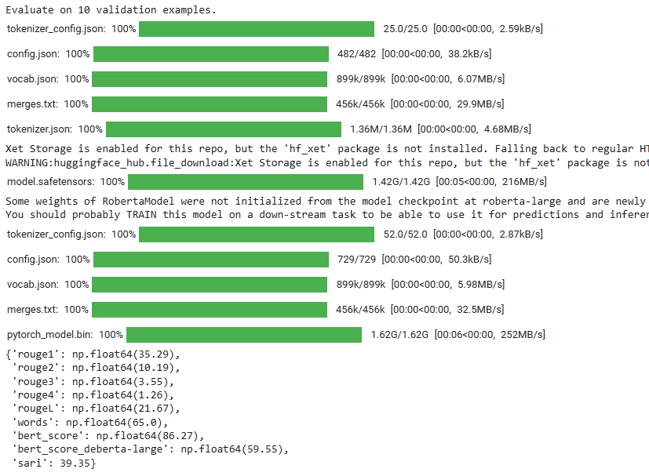
Results
Prompt 1
3 shot
Gpt turbo 3.5

Slide 8
GPT4 and GPT-turbo 3.5
Prompt : {You are a helpful assistant …
Environment | R-1 | R-2 | R-3 | R-4 | R-L | BERTScore | Deberta | SARI | Words
GPT-3.5-turbo(1 shot) | 35.29 | 10.19 | 3.55 | 1.26 | 21.67 | 86.27 | 59.55 | 39.35 | 65
GPT-4 (3 shot) | 42.89 | 13.42 | 5.24 | 1.74 | 25.04 | 87.49 | 62.58 | 44.11 | 105.9

Slide 9
Improve Reproducibility
Lot of amazing stuff but can improve on these …
Annotations are most important for this project, but hard to understand and reproduce. Wish we could run the annotation tool ourselves to understand better. Medtator tool was missing.
Datasets can be organized better, was very hard to find references and took a long time
Annotator paths, some xml files and some txt files mentioned, we couldn’t find it.

Slide 10
Additional Extensions
Fine-tune DL4H-style LLMs to generate personalized, emotionally sensitive, and literacy-matched versions of clinical summaries for patients
We implemented this idea by producing "empathy summaries" using an OpenAI API key and gpt-4o, and we produced interesting results.
Real-Time Risk Flagging and Intervention Suggestions from Streaming Clinical Notes
Narrative Disparity Detection to Reduce Bias in Documentation and Care

Slide 11
References and Datasets
Medical Expert Annotations of Unsupported Facts in Doctor-Written and LLM-Generated Patient Summaries
MIMIC-IV-Note: Deidentified free-text clinical notes v2.2
What's new in MIMIC-IV? | MIMIC
A Data-Centric Approach To Generate Faithful and High Quality Patient Summaries with Large Language Models
https://github.com/stefanhgm/patient_summaries_with_llms
https://physionet.org/content/ann-pt-summ/get-zip/1.0.0/

